Slide 1

NIE INSTITUTE OF TECHNOLOGY Department of Electronics and Communication Mini Project Phase 3 – Presentation of Contactless Switch For Home Automation Under Guidance of Mr. S.N. Prasad
Sudarshana Chakravarthy(4NN18EC045)
Divakar U(4NN18EC009)
Suraj Sharma S(4NN18EC046)
Ningaraju A.M(4NN18EC024)

Slide 2
Outline :
• Introduction
• Literature survey
• Problem definition
• Block diagram representation
• Advantages and drawbacks
• Applications
• Timeline
• Cost of material
• References.

Slide 3
Introduction :
Scientists have made it clear that the coronavirus can live on surfaces for hours and light switches are one of the many ways the disease can be transmitted.
To avoid the risk of contracting COVID-19, it has become important to not touch surfaces of buttons and keys that have been frequently used by other people. This calls for a need to innovate the switching technology for replacing a hand-operated switch, with an automatic contactless switch.

Slide 4
Literature survey:
Gesture-based intuitive interactions with electronic devices can be an important part of smart home systems.
In this paper, we adapt the contactless linear gesture sensor for the navigation of smart lighting system.
Set of handled gestures allow to propose two methods of active light source selection, continuous dimming, and turning on and off based on discrete gestures.
The average gesture recognition accuracy was 97.58% in the first of proposed methods of lamp selection and 95.45% in the second method.
Apart of the accuracy of the gesture sensor in the real case implementation the user convenience of navigation was monitored.
72.73% of users pointed the first method as more intuitive and convenient to use. 63.64% of users indicated that the dimming of light is more intuitive when moving a hand along the sensor than closing it towards the package.
The impact of utilizing dirty or gloved hand on the pose recognition accuracy of the sensor was verified as well. The results indicate the capability of incorporating considered touchless gesture sensor to homes, factories or operating rooms.
These are places where the need of the functionality of discrete and continuous gestures for handling some basic devices or functions can be limited due to dirty hand scenarios or sterility requirements.
https://www.researchgate.net/publication/330142544_Towards_Contactless_Hand_Gestures-Based_Control_of_Devices

Slide 5
Problem Statement:
Social distancing, online meetings and minimal contact have become the new norm and the world has only just about digested this as the new reality.
Saying ‘no’ to meeting in person, pulling your hand away when someone extends to shake it as a greeting would’ve seemed extremely impolite seven months ago.
The world has gone through some really rough changes and everyone's life has changes in one way or the other.
With this change in everyone’s lifestyle, people have become more aware and precautious to not contribute to the pandemic’s spread
The American Centers for Disease Control and Prevention (CDC) has published a guideline detailing how to clean and disinfect your households. An excerpt from the article :
“Community members can practice routine cleaning of frequently touched surfaces (for example: tables, doorknobs, light switches, handles, desks, toilets, faucets, sinks, and electronics with household cleaners and EPA-registered disinfectant that are appropriate for the surface, following label instructions.”
The understanding is that the coronavirus and other viruses/germs can live on surfaces for a few hours or days, but the exact duration is debated and varies based on the environment and surroundings. Still, the general consensus is that keeping surfaces clean is required.

Slide 6
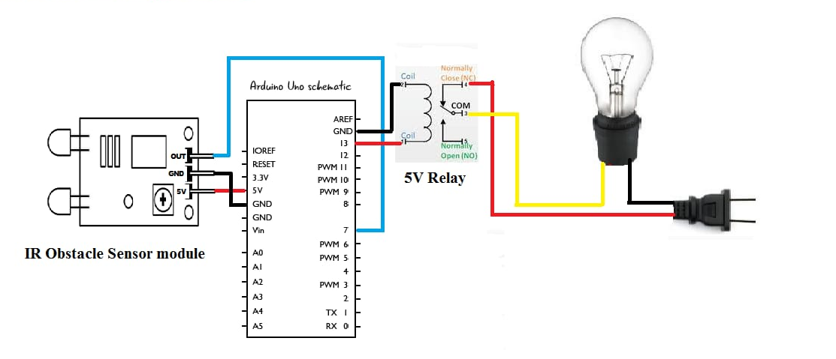
Block Diagram:
Fig.1-Block diagram of Contactless Switch.

Slide 7
Main Components :
Infrared Obstacle Avoidance IR Sensor Module : Infrared Obstacle Avoidance IR Sensor Module (Active Low) has a pair of infrared transmitting and receiving tubes. When the transmitted light waves are reflected back, the reflected IR waves will be received by the receiver tube. The onboard comparator circuitry does the processing and the green indicator LED comes to life.
Arduino Uno : The Arduino Uno is an open-source microcontroller board based on the Microchip ATmega328P microcontroller and developed by Arduino.cc.The board is equipped with sets of digital and analog input/output (I/O) pins that may be interfaced to various expansion boards (shields) and other circuits. The board has 14 digital I/O pins (six capable of PWM output), 6 analog I/O pins, and is programmable with the Arduino IDE (Integrated Development Environment), via a type B USB cable.

Slide 8
Relay : A relay can be defined as a switch. Switches are generally used to close or open the circuit manually .Relay is also a switch that connects or disconnects two circuits. But instead of manual operation a relay is applied with electrical signal, which in turn connects or disconnects another circuit.
Jumper Wires : A jump wire (also known as jumper, jumper wire, jumper cable, DuPont wire or cable) is an electrical wire, or group of them in a cable, with a connector or pin at each end (or sometimes without them – simply "tinned"), which is normally used to interconnect the components of a breadboard or other prototype or test circuit, internally or with other equipment or components, without soldering.

Slide 9
Advantages :
Safe and Hygiene : prevents transfer of germs, bacteria & virus
Prevents dirt on walls and switch plate
Hands-free convenience

Slide 10
Disadvantages :
Costlier compared to normal switch control system
It is difficult to control things when it is outside Line of sight
Setup and Configuration
Additional Devices required

Slide 11
Applications :
Hospitals
Factories
Elevators
Hotels and Restaurant

Slide 12
Timeline
Phase 1
Introduction, Literature, Problem Definition, Block Diagram, Advantages, Drawbacks, Applications, Cost and References
Software, Hardware, Circuit Diagram, Simulation Results
Phase 3
Demonstration of Implemented MiniProject with Effective Presentations by Combining Phase 1 and Phase 2 Presentation
Phase 2
JUNE
MAY
JULY

Slide 13
Cost of the material :
Components | Cost(Rupees)
Arduino UNO | 520
Infrared Obstacle IR Sensor Module | 30
Relay | 59
Bulb | 90
Bulb Holder | 120
Jumper Wires | 70
TOTAL(Approximate) | 900

Slide 14
Software Requirement:
Arduino IDE :
The Arduino Integrated Development Environment (IDE) is a cross-platform application (for Windows, macOS, Linux) that is written in functions from C and C++. It is used to write and upload programs to Arduino compatible boards, but also, with the help of third-party cores, other vendor development boards.
The source code for the IDE is released under the GNU General Public License, version 2. The Arduino IDE supports the languages C and C++ using special rules of code structuring. The Arduino IDE supplies a software library from the Wiring project, which provides many common input and output procedures.

Slide 15
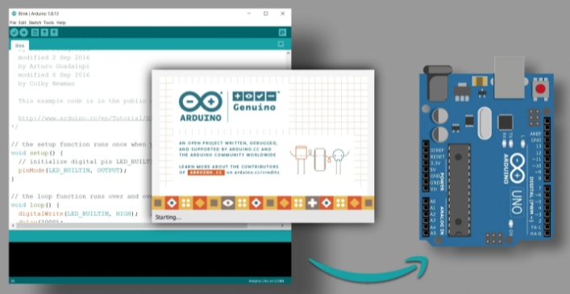

Slide 16

Tinkercad
Tinkercad is a free-of-charge, online 3D modeling program that runs in a web browser, known for its simplicity and ease of use. Since it became available in 2011 it has become a popular platform for creating models for 3D printing

Slide 17
Hardware Requirement:
Infrared Obstacle Avoidance IR Sensor Module
Arduino Uno
Relay
Jumper Wires
Light Bulb

Slide 18
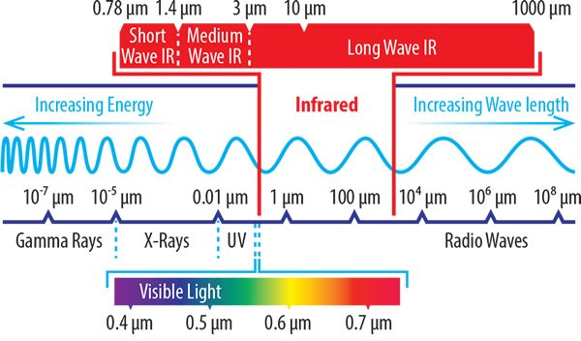
Infrared Rays:
Infrared (IR), sometimes called infrared light, is electromagnetic radiation (EMR) with wavelengths longer than those of visible light. It is therefore invisible to the human eye. IR is generally understood to encompass wavelengths from the nominal red edge of the visible spectrum around 700 nanometers (frequency 430 THz), to 1 millimeter (300 GHz)(although the longer IR wavelengths are often designated rather as terahertz radiation). Black-body radiation from objects near room temperature is almost all at infrared wavelengths. As a form of electromagnetic radiation, IR propagates energy and momentum, with properties corresponding to both those of a wave and of a particle, the photon.

Slide 19
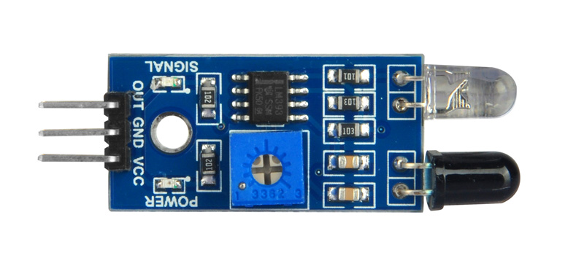
Infrared Obstacle Avoidance IR Sensor Module
IR Infrared Obstacle Avoidance Sensor Module has a pair of infrared transmitting and receiving tubes. When the transmitted light waves are reflected back, the reflected IR waves will be received by the receiver tube. The onboard comparator circuitry does the processing and the green indicator LED comes to life.
The module features a 3 wire interface with Vcc, GND and an OUTPUT pin on its tail. It works fine with 3v3 to 5V levels. Upon hindrance/reflectance, the output pin gives out a digital signal (a low level signal). The onboard preset helps to fine tune the range of operation, effective distance range is 2cm to 80cm.

Slide 20
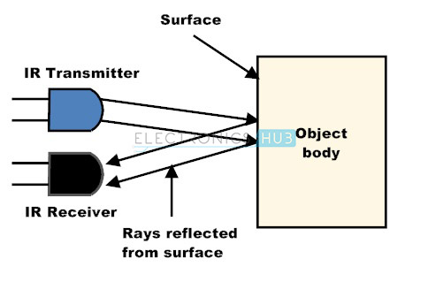

Slide 21
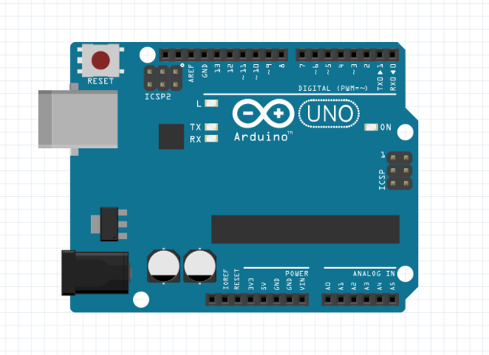
Arduino Uno
The Arduino Uno is an open-source microcontroller board based on the Microchip ATmega328P microcontroller and developed by Arduino.cc. The board is equipped with sets of digital and analog input/output (I/O) pins that may be interfaced to various expansion boards (shields) and other circuits. The board has 14 digital I/O pins (six capable of PWM output), 6 analog I/O pins, and is programmable with the Arduino IDE (Integrated Development Environment), via a type B USB cable. It can be powered by the USB cable or by an external 9-volt battery, though it accepts voltages between 7 and 20 volts.

Slide 22
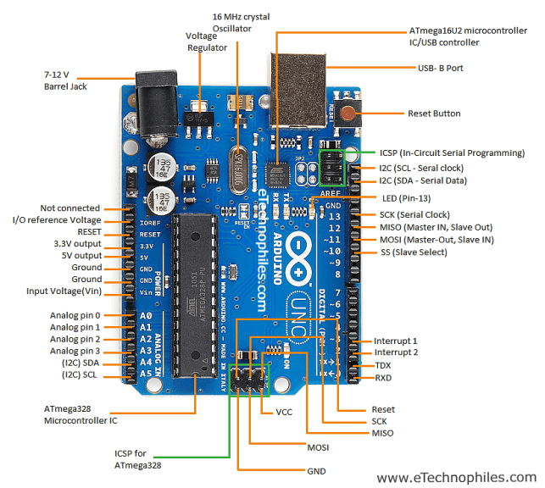

Slide 23
Technical specifications
Microcontroller: Microchip ATmega328P
Operating Voltage: 5 Volts
Input Voltage: 7 to 20 Volts
Digital I/O Pins: 14 (of which 6 can provide PWM output)
UART: 1
I2C: 1
SPPI: 1
Analog Input Pins: 6
DC Current per I/O Pin: 20 mA
DC Current for 3.3V Pin: 50 mA
Flash Memory: 32 KB of which 0.5 KB used by bootloader
SRAM: 2 KB
EEPROM: 1 KB
Clock Speed: 16 MHz

Slide 24
General pin functions
LED: There is a built-in LED driven by digital pin 13. When the pin is high value, the LED is on, when the pin is low, it is off.
VIN: The input voltage to the Arduino board when it is using an external power source (as opposed to 5 volts from the USB connection or other regulated power source). You can supply voltage through this pin, or, if supplying voltage via the power jack, access it through this pin.
5V: This pin outputs a regulated 5V from the regulator on the board. The board can be supplied with power either from the DC power jack (7 - 20V), the USB connector (5V), or the VIN pin of the board (7-20V). Supplying voltage via the 5V or 3.3V pins bypasses the regulator, and can damage the board.
3V3: A 3.3 volt supply generated by the on-board regulator. Maximum current draw is 50 mA.
GND: Ground pins.
IOREF: This pin on the Arduino board provides the voltage reference with which the microcontroller operates. A properly configured shield can read the IOREF pin voltage and select the appropriate power source, or enable voltage translators on the outputs to work with the 5V or 3.3V.
Reset: Typically used to add a reset button to shields that block the one on the board.

Slide 25
Special pin functions
Each of the 14 digital pins and 6 analog pins on the Uno can be used as an input or output, under software control (using pinMode(), digitalWrite(), and digitalRead() functions). They operate at 5 volts. Each pin can provide or receive 20 mA as the recommended operating condition and has an internal pull-up resistor (disconnected by default) of 20-50K ohm. A maximum of 40mA must not be exceeded on any I/O pin to avoid permanent damage to the microcontroller. The Uno has 6 analog inputs, labeled A0 through A5; each provides 10 bits of resolution (i.e. 1024 different values). By default, they measure from ground to 5 volts, though it is possible to change the upper end of the range using the AREF pin and the analogReference() function.
Serial / UART: pins 0 (RX) and 1 (TX). Used to receive (RX) and transmit (TX) TTL serial data. These pins are connected to the corresponding pins of the ATmega8U2 USB-to-TTL serial chip.
External interrupts: pins 2 and 3. These pins can be configured to trigger an interrupt on a low value, a rising or falling edge, or a change in value.
PWM (pulse-width modulation): pins 3, 5, 6, 9, 10, and 11. Can provide 8-bit PWM output with the analogWrite() function.
SPI (Serial Peripheral Interface): pins 10 (SS), 11 (MOSI), 12 (MISO), and 13 (SCK). These pins support SPI communication using the SPI library.
TWI (two-wire interface) / I²C: pin SDA (A4) and pin SCL (A5). Support TWI communication using the Wire library.
AREF (analog reference): Reference voltage for the analog inputs.

Slide 26
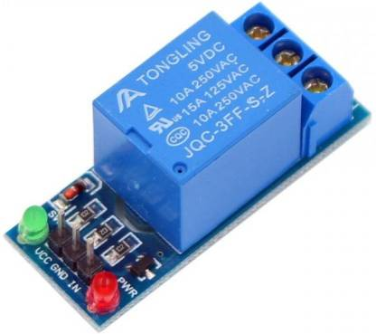
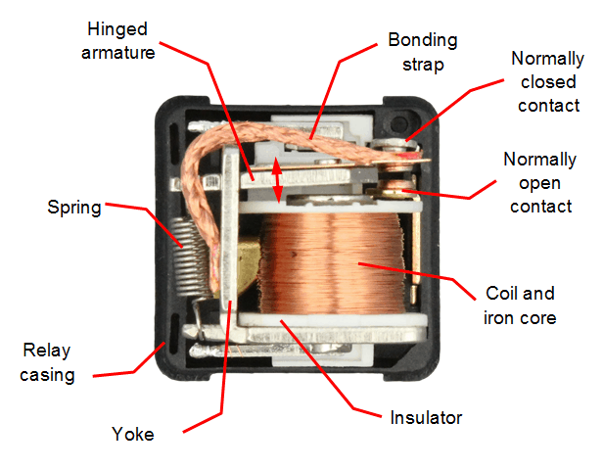
Relay
A relay can be defined as a switch. Switches are generally used to close or open the circuit manually .Relay is also a switch that connects or disconnects two circuits. But instead of manual operation a relay is applied with electrical signal, which in turn connects or disconnects another circuit.
Every electromechanical relay consists of an
Electromagnet
Mechanically movable contact
Switching points and
Spring

Slide 27
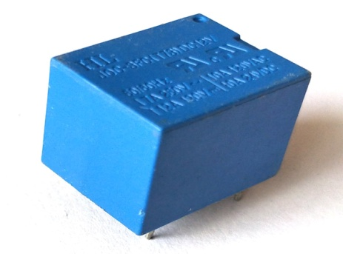
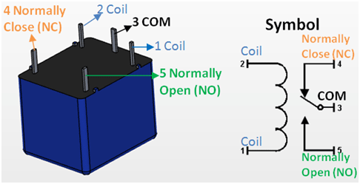
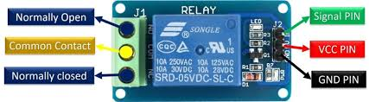
5V 5-Pin Relay Module 5V Relay Pin Diagram

Slide 29
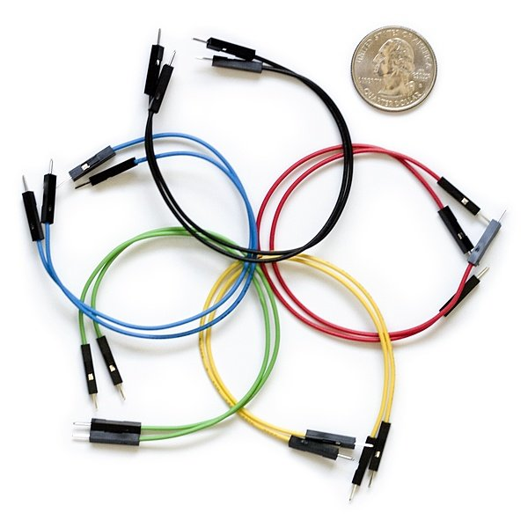
Jumper Wires
A jump wire (also known as jumper, jumper wire, jumper cable, DuPont wire or cable) is an electrical wire, or group of them in a cable, with a connector or pin at each end (or sometimes without them – simply "tinned"), which is normally used to interconnect the components of a breadboard or other prototype or test circuit, internally or with other equipment or components, without soldering.
Types
Solid tips
Crocodile clips
Banana connectors
Registered jack
RCA connectors
RF connectors

Slide 30
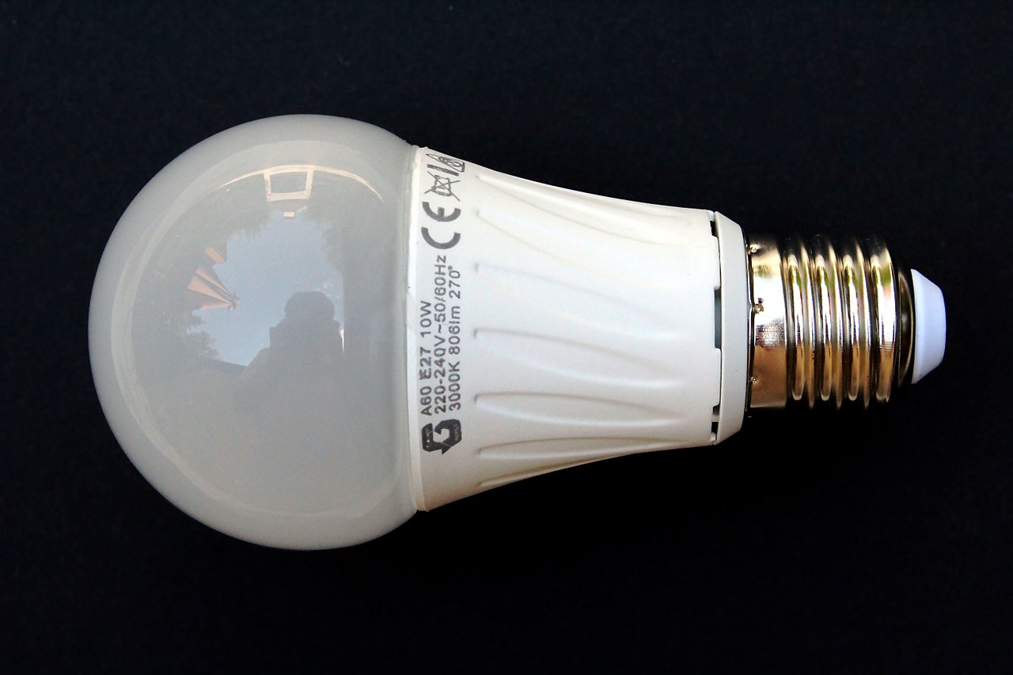
Lightbulb (LED)
An LED lamp or LED light bulb is an electric light that produces light using light-emitting diodes (LEDs). LED lamps are significantly more energy-efficient than equivalent incandescent lamps and can be significantly more efficient than most fluorescent lamps, The most efficient commercially available LED lamps have efficiencies of 200 lumens per watt (Lm/W). Commercial LED lamps have a lifespan many times longer than incandescent lamps.

Slide 31
Circuit Diagram:

Slide 32
Code
#define r1 13
int relay1 = LOW;
int obstaclePin = 7; // This is our input pin
int hasObstacle = HIGH;
void setup()
{
pinMode(r1, OUTPUT);
pinMode(obstaclePin, INPUT);
Serial.begin(9600);
}
void loop() {
hasObstacle = digitalRead(obstaclePin);
if (hasObstacle == LOW)

Slide 33
{
relay1 = ~ relay1;
digitalWrite(r1,relay1);
delay(1000);
}
delay(200);
}

Slide 34
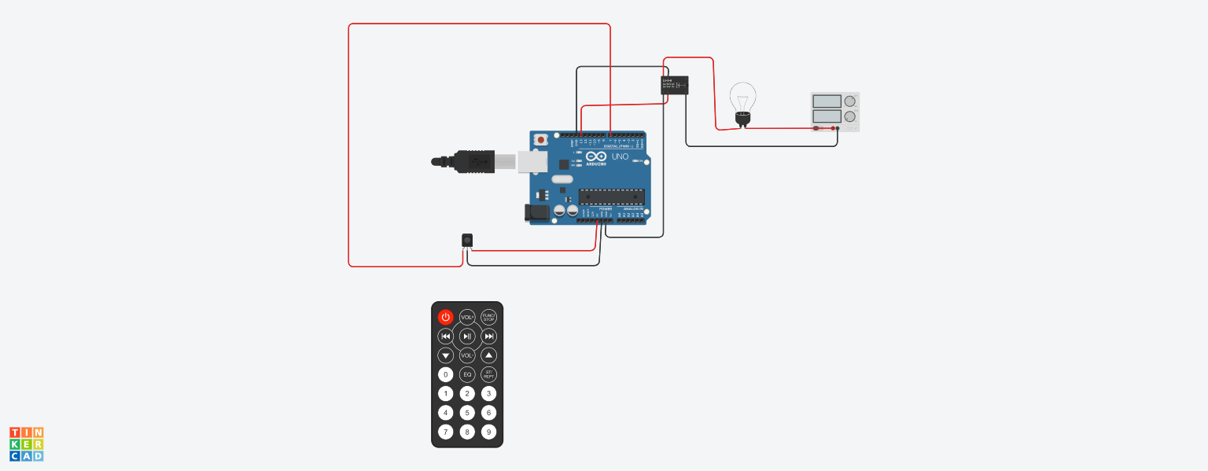
Simulation

Slide 35
References:
https://create.arduino.cc/projecthub/munir03125344286/touch-less-switch-5c7169
https://electricalreview.co.uk/2020/09/25/how-contactless-lighting-control-can-help-with-covid-19/
https://www.toyamaworld.com/post/covid-19-and-the-importance-of-home-automation-and-contactless-solutions
https://www.electronicsforu.com/electronics-projects/automatic-contactless-switch-for-smart-home
https://www.researchgate.net/publication/330142544_Towards_Contactless_Hand_Gestures-Based_Control_of_Devices

Slide 36

36

